Slide 1
Public Key Cryptography
Authentication
Part Three

Slide 2
Digital Signatures
Message authentication does not address issues of lack of trust
Digital signatures provide the ability to:
  verify author, date & time of signature
  authenticate message contents
  be verified by third parties to resolve disputes
hence include authentication function with additional capabilities
Notes:
The most important development from the work on public-key cryptography is the digital signature. Message authentication protects two parties who exchange messages from any third party. However, it does not protect the two parties against each other either fraudulently creating, or denying creation, of a message. A digital signature is analogous to the handwritten signature, and provides a set of security capabilities that would be difficult to implement in any other way. It must have the following properties:
• It must verify the author and the date and time of the signature
• It must to authenticate the contents at the time of the signature
• It must be verifiable by third parties, to resolve disputes
Thus, the digital signature function includes the authentication function.

Slide 3
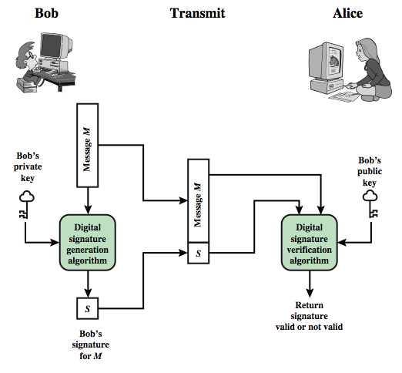
Digital Signature Model A
Notes:
This Figure is a generic model of the process of making and using digital signatures. Bob can sign a message using a digital signature generation algorithm. The inputs to the algorithm are the message and Bob's private key. Any other user, say Alice, can verify the signature using a verification algorithm, whose inputs are the message, the signature, and Bob's public key.

Slide 4
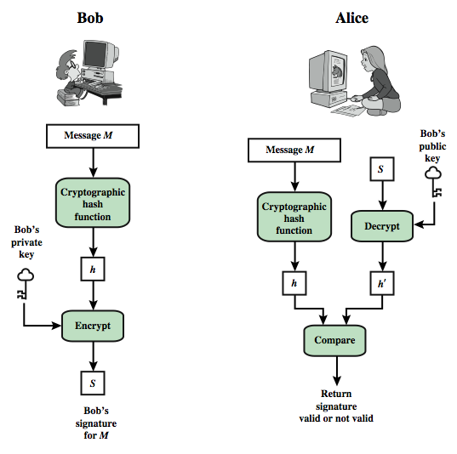
Digital Signature Model B
+
Message M
+
S
Notes:
In simplified terms, the essence of the digital signature mechanism is shown in this figure.

